Slide 1
Improve Building Sustainability with data
Academic Supervisor: Dr. Grechuk Bogdan
Industrial Supervisor: Vishal Sharma - Product Strategic Lead at SmartViz
Name: Srijeet Mohan Nair
Student ID: 229001998

Slide 2




introduction
AIM
Through data-driven insights and predictive modelling, enhance building sustainability.
Use SmartViz's extensive dataset to discover connections between temperature, occupancy, CO2 emissions, and humidity, and then construct forecasting models for enhanced performance of the building.
APPROACH
Data preprocessing is a MUST!
Data cleaning (most important)

Slide 3




DATA Cleaning
Crucial and integral part of Data Preprocessing pipeline
Initial stage of cleaning
Removing duplicate rows and missing value rows from the data.
Ensuring data integrity
DATASET?
XBuildings temp, co2, humidity, Occupancy Raw Data until 20230712.xlsx
5 columns – project_name, time, value, geometry_name , metric_name
Original raw data (530164 rows)
Cleansed data(initial)
(528547 rows)

Slide 4
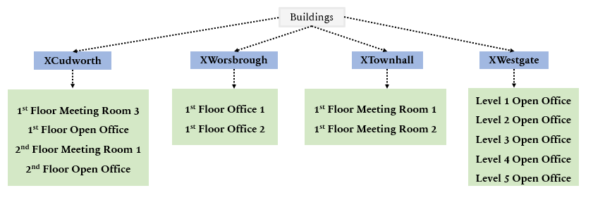
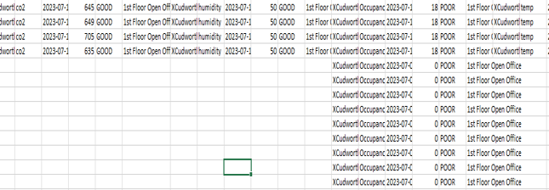
DATA SPLITTING
1
2
2 datasets for each building’s geometry/zone/section – After initial clean, Original dataset
Determining correlations between the 4 metrics.
But Occupancy metric data count differs (more) than the other 3 metrics.

Slide 5
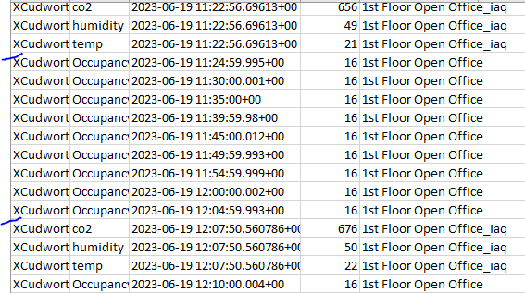

More Deep cleaning Required...
Repeating or duplicate data for Occupancy metric which was making it redundant
The recorded data not in one particular ‘metrics’ order
Occupancy followed by other 3 metrics
The inconsistent data (any spike or data value growth observed)
Data records that excludes the metric value benchmark.
XCudworth – 1st Floor Open Office (geometry name)
How was it handled?
Lead function
Lag function
iv. Update and delete out of benchmark
values

Slide 6
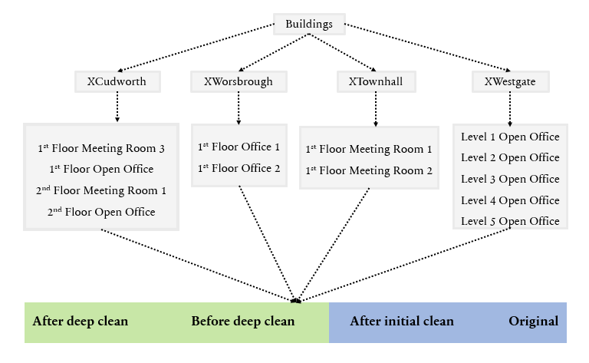
How Many datasets now?
How Many datasets now?

Slide 7
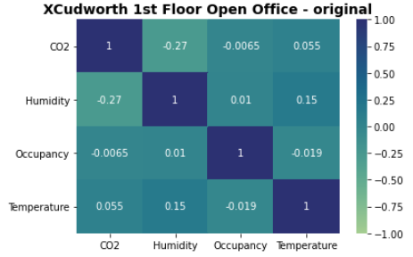
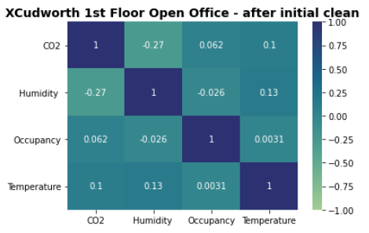
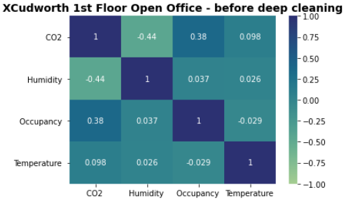
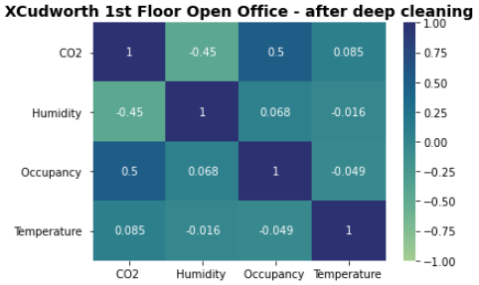
Correlation Matrix
For each building’s geometry, Correlation between 4 metrics – CO2, Humidity, Temperature, Occupancy were computed.
Building Geometry/Zone/Section – XCudworth 1st Floor Open Office

Slide 8

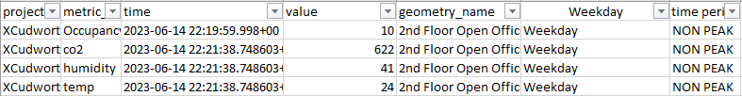

More data segregation...
Sliced and diced the datasets for weekdays and weekends.
Weekdays further segregated for peak hours and non-peak hours.
For Weekday - 9am to 5pm – Peak hours, 5pm onwards till 9am – non-peak hours

Slide 9
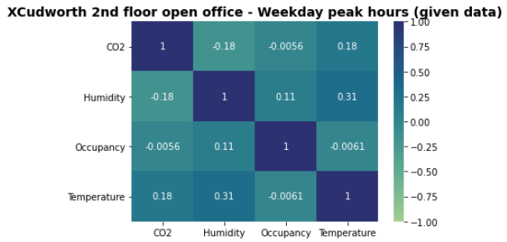
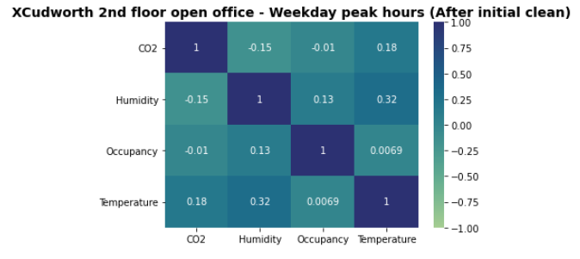
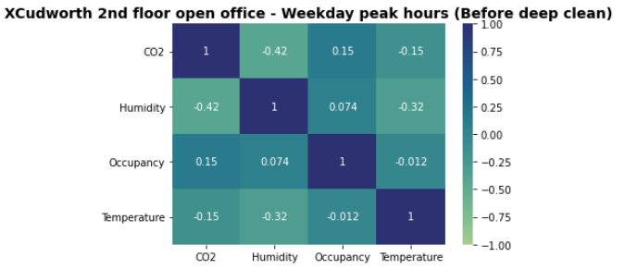
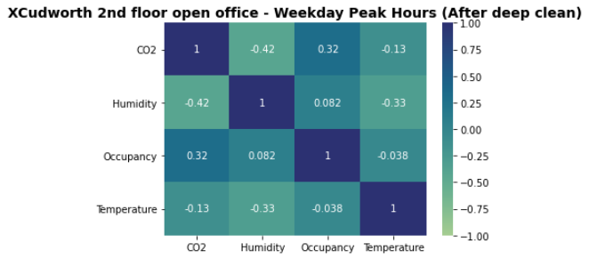
Correlation Matrix Weekday Peak Hours
Building Geometry Room – XCudworth 2nd Floor Open Office

Slide 10


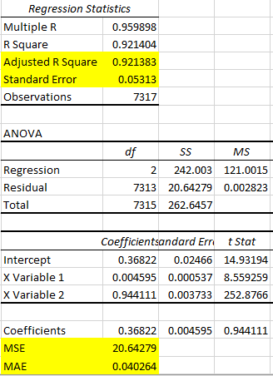
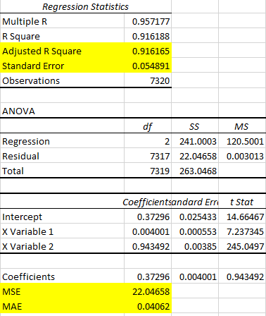
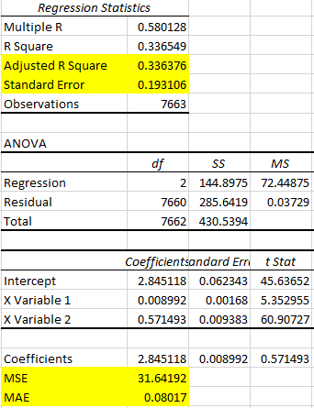
CORRELATION SIGNIFICANCE CHECK SIMPLE LINEAR REGRESSION STATISTIC
4 datasets – after deep clean, before deep clean, after initial clean and original
Which dataset’s correlation more precise
Which dataset should be considered for forecasting each metrics for each buildings
Simple Linear Regression statistic (Explanatory variable – Occupancy,
Response variable – CO2, Humidity)
After deep
clean
Before deep clean
After initial clean

Slide 11
Datasets
after deep clean

Slide 12
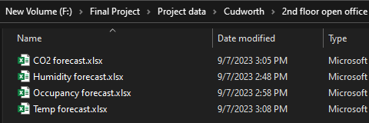

Forecasting Models
Forecasting models are used to forecast future trends and outcomes, enabling more informed decision-making, resource allocation, and risk management.
Each building geometry has 4 different datasets - one for each of the parameter/metric.
70% training set data and 30% test set data (actual vs predicted, future dates forecasting)
Developed models:
ARIMA model
SARIMA model
Prophet model
Forecasted timestamp is every 5mins (same as actual/original data’s timestamp)
AIC score to determine parameters value.

Slide 13
FORECASTING MODELS Implementation
Buildings
XCudworth
XWorsbrough
XTownhall
XWestgate
1st Floor Meeting Room 3
1st Floor Open Office
2nd Floor Meeting Room 1
2nd Floor Open Office
1st Floor Office 1
1st Floor Office 2
1st Floor Meeting Room 1
1st Floor Meeting Room 2
Level 1 Open Office
Level 2 Open Office
Level 3 Open Office
Level 4 Open Office
Level 5 Open Office
4 metrics – CO2, Humidity, Temperature, Occupancy datasets
ARIMA model
SARIMA model
Prophet model

Slide 14
Forecasting Models comparison - Performance Metrics
MSE (Mean Square Error)
RMSE (Root Mean Square Error)
MAE (Mean Absolute Error)
Composite score – An evaluation metric to determine the accuracy score for the model using the MSE, RMSE and MAE value.
Weights are assigned for each metric that would sum up to 1.
For optimal consideration, the value should be less as we calculate it using lower values of MSE, RMSE and MAE.
Formula used → 0.3 x MSE + 0.3 x RMSE + 0.4 x MAE

Slide 15
Forecasting Models comparison(Result)
Building – XCudworth
Geometry room – 1st Floor Meeting Room 3
1st Floor Meeting Room 3 | Parameters | Models | MSE | RMSE | MAE | Composite Score
1st Floor Meeting Room 1 | CO2 | ARIMA | 14913.017 | 122.118 | 117.143 | 6036.985
Q2 |  | SARIMA | 37081.046 | 192.564 | 167.670 | 14940.489
Q3 |  | Prophet | 13457.499 | 116.006 | 99.471 | 5447.643
Q4 | Humidity | ARIMA | 4.77816 | 2.18590 | 1.90345 | 3.13807
 |  | SARIMA | 0.32816 | 0.57285 | 0.42800 | 0.431527
 |  | Prophet | 1.88932 | 1.37452 | 1.23654 | 1.53905
 | Temperature | ARIMA | 3.47306 | 1.86361 | 1.77102 | 2.47961
 |  | SARIMA | 0.71233 | 0.84400 | 0.80969 | 0.78104
 |  | Prophet | 0.17317 | 0.41613 | 0.35325 | 0.30008
 | Occupancy | ARIMA | 0.30015 | 0.54786 | 0.50885 | 0.43707
 |  | SARIMA | 0.00014 | 0.01169 | 0.01031 | 0.00665
 |  | Prophet | 0.08200 | 0.28635 | 0.12995 | 0.15769

Slide 16
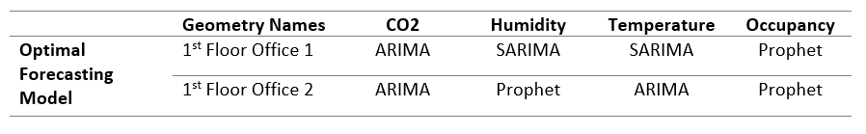
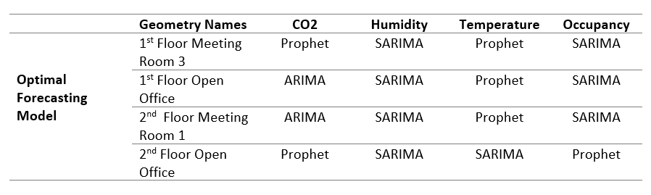
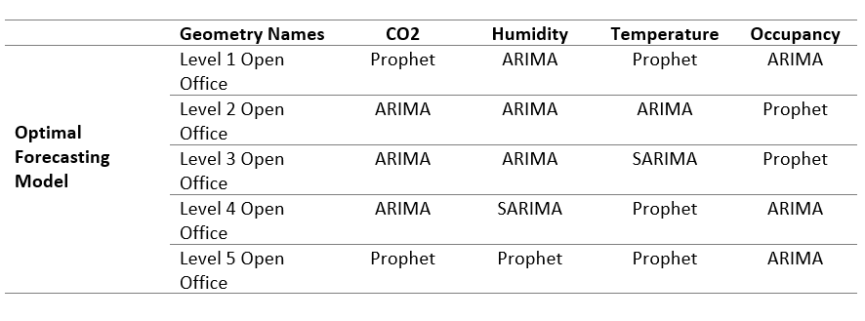
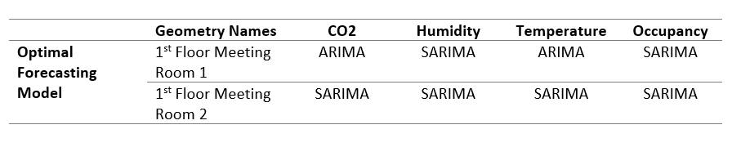
Summary - Optimal forecasting models for each building
xworsbrough
XCudworth
XWestgate
Xtownhall

Slide 17
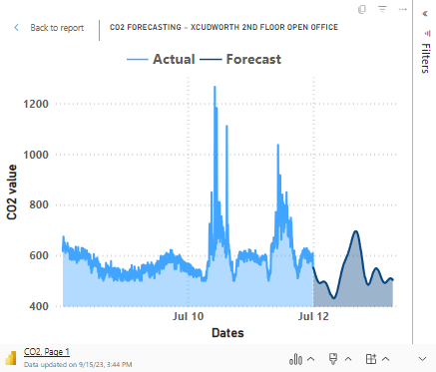
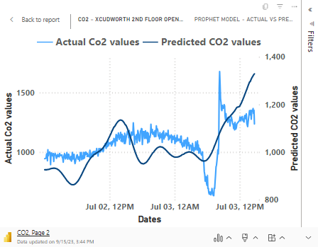
FORECASTING Visualization with Optimal model
Building Geometry Room – XCudworth 2nd Floor Open Office (Optimal model – Prophet)

Slide 18
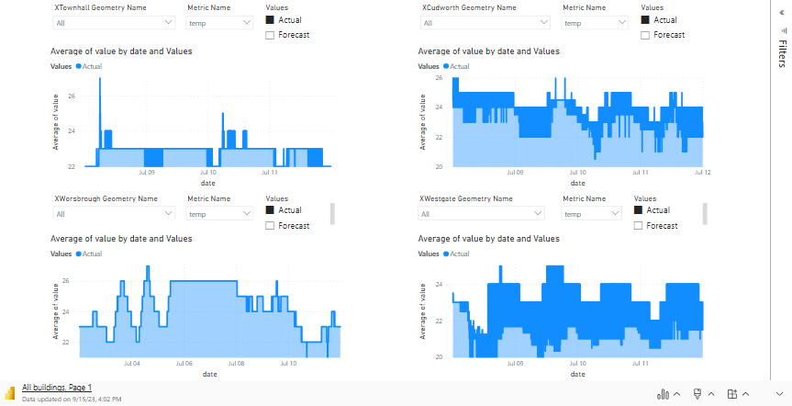
Interactive Forecasting report generation
An interactive way to show forecasting of each metrics for the desired building.

Slide 19
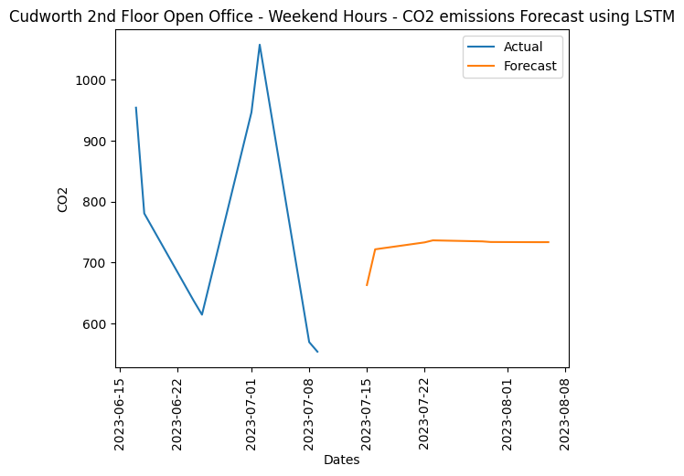
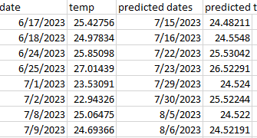
ANY OTHER MODELS TRIED?
Initially developed Long Short-Term Memory (LSTM) model
WHY WAS IT NOT CONSIDERED?
No good forecasting results(steady line) and poor performance
WHAT WAS THE CONSIDERED TIMESTAMP FOR FORECASTING?
Day-wise timestamp + partitioned dataset → count of data records became less → less effective or precise results
Actual/Original data records timestamp 5mins

Slide 20


Key Benefits
More Comprehensive Sustainability Insights
Decision-Making Driven by Data
Capabilities for Predictive Analysis
FURTHER IMPROVEMENTS
Energy usage dependence for the buildings
Incorporating additional parameters like air quality, lighting, and water usage
Climate Adaptation

Slide 21










WORK-FLOW AND CONCLUSION
( 2 datasets per building room)
IoT sensor real-time
datasets
Initial data cleaning
Data splitting
Correlation analysis
(correlation significance check)
( 4 datasets per building room)
( 1 dataset per building room)
Correlation analysis
Partitioning each dataset – Weekday peak & non-peak, Weekend hours
Correlation analysis
Deep data cleaning
(For each metric of each building room)
Enhance performance of each building and its geometry/zone/section with respect to CO2, Humidity, Occupancy and Temperature metrics
Forecasting models
Optimal Forecasting
model

Slide 22
THANK YOU
Academic Supervisor: Dr. Grechuk Bogdan
Industrial Supervisor: Vishal Sharma - Product Strategic Lead at SmartViz

